Slide 1
Interaksi Manusia dan Komputer (IMK)
Overview User-Centered Design
Overview Proses Desain User Interface

Slide 2
Interaksi Manusia dan Komputer (IMK)
Overview User-Centered Design

Slide 3
Tujuan
Setelah mengikuti materi ini mahasiswa dapat:
Mengetahui proses yang dilakukan pada desain User Interface

Slide 4
Overview User Centered Design (UCD)

Slide 5
What is User-Centered Design?
An approach to UI development and system development.
Focuses on understanding:
Users, and
Their goals and tasks, and
The environment (physical, organizational, social)
Pay attention to these throughout development

Slide 6
ISO on User-centered Design
ISO 13407 describes human-centered design processes for interactive systems
Principles of human-centered design:
Active involvement of users
Appropriate allocation of function between user and system
Iteration of design solutions
Multidisciplinary design teams

Slide 7
What is a user-centered approach?
User-centered approach is based on:
Early focus on users and tasks: directly studying cognitive, behavioral, anthropomorphic & attitudinal characteristics
Empirical measurement: users’ reactions and performance to scenarios, manuals, simulations & prototypes are observed, recorded and analysed
Iterative design: when problems are found in user testing, fix them and carry out more tests

Slide 8
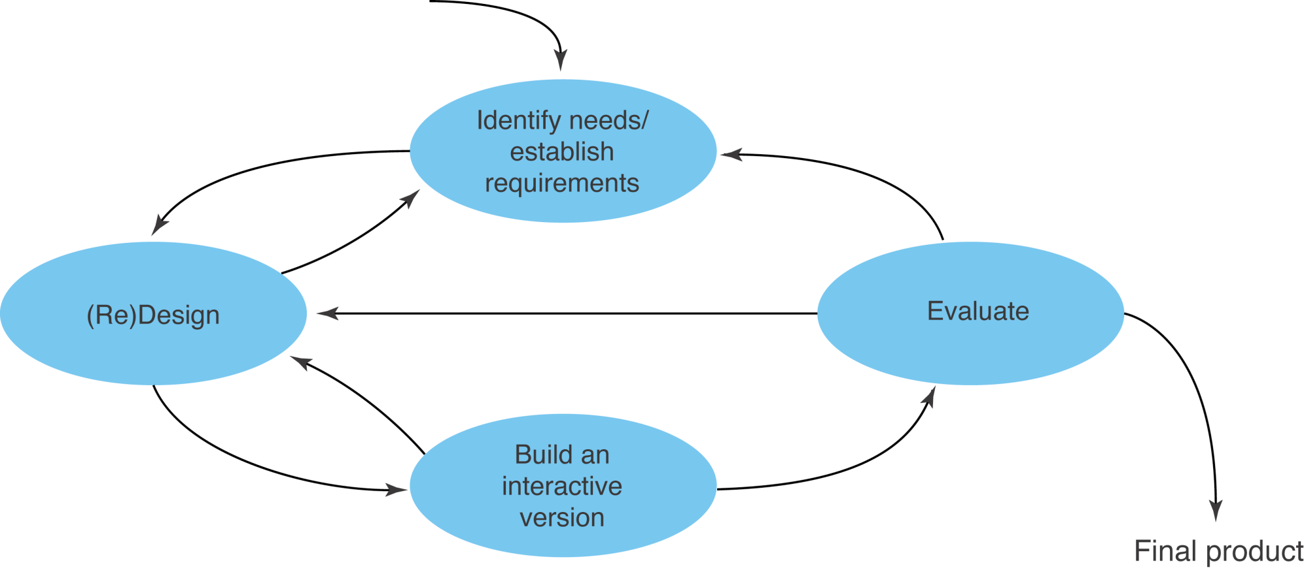
A simple interaction design model
Exemplifies a user-centered design approach

Slide 9
1. Identifying needs and establishing requirements
Some practical issues
Who are the users?
What are ‘needs’?

Slide 10
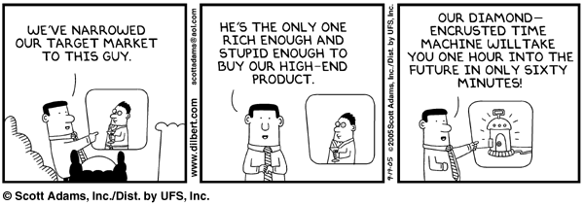
Target users

Slide 11
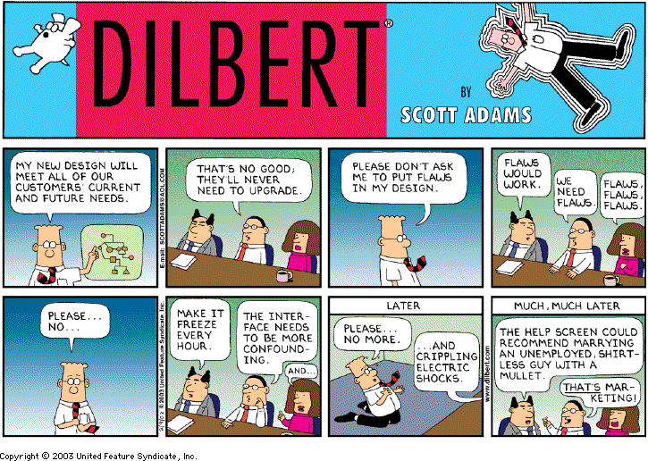
Users’ needs

Slide 12
Brief overview of common methods to gather user data
Interviews
Questionnaires
Observation
Choosing and combining techniques

Slide 13
2. Developing alternative designs
Competitive/Comparative Analysis,
Try using similar services or products in order to find out:
Current trends in the marketplace
What expectations your users will have
What to do, what not to do
Interface conventions
“Must have” standard features
Heuristic Evaluation,
Evaluate an existing interface (or new interface concept) based on set of usability criteria
Mostly used to highlight usability problems and deficiencies
May or may not propose usability solutions
Identified problem areas are addressed by subsequent design work
Normally done with expert evaluators, but it can be a valuable tool for anyone
One detailed checklist: http://www.stcsig.org/usability/topics/articles/he-checklist.html

Slide 14
2. Developing alternative designs
Persona,
Models of “archetypical” users culled from user research
Each persona is a description of one particular “typical” user of your system
Personas may be combined if they have the same (or sometimes overlapping) goals
Places the focus on specific users rather than on "everyone”
Goals, Tasks & Scenarios,
Goals:
Are what the user wants to do, but not how the user achieves them
Tasks:
Describe the steps necessary to achieve the goals
Can vary with the available technology
Are broken down into steps for task analysis, and are recombined into sequence of steps for scenario development
Designers can reorganize, combine, or remove tasks currently performed to help users achieve their goals more efficiently
Scenarios:
Written description of a persona achieving a goal through a set of tasks in a specific context
Should start technology-neutral and become more specific as the design progresses

Slide 15
3. Building interactive versions of the designs
Start rough
Explore!
Use personas to keep the users in view
Use scenarios to inform the design
Get frequent feedback
Note user conventions
Make design artifacts public
May be expressed in a prototype for usability testing
Design
Prototype
Evaluate

Slide 16
4. Evaluating designs
Let users validate or invalidate the design
Ask the user to complete selected typical tasks (from scenarios) and think aloud while they do it
Test early in the process
Can test with 3-5 users (or less!)
“Formal” testing
Measures “success”
Set success criteria prior to testing (best done at the project outset)
Compare to baseline if you have one
Have usability problems revealed in the heuristic evaluation been addressed?

Slide 17
5. Evaluating designs
Define what is to be tested
Select users based on personas
Administer the tests
Analyze the data
Document the findings in a brief
Share the findings with the development team
Determine what design changes will be made based on test results

Slide 18
Interaksi Manusia dan Komputer (IMK)
THE USER INTERFACE (UI) DESIGN PROCESS
Overview Proses Desain UI

Slide 19
Proses Desain UI (14 Step)
Step 1 : Know Users
Step 2 : Understand Business Function
Step 3 : Understand the Principles of Good Interface and Screen Design
Step 4 : Develop System Menu & Navigation
Step 5 : Proper Windows
Step 6 : Proper Interaction Device
Step 7 : Screen-based controls
Step 8 : Clear text & message
Step 9 : Provide Effective Feedback
Step 10 : Internasionalization & Accessibility
Step 11 : Create Meaningful Graphics, Icons, and Images
Step 12 : Choose Proper Colours
Step 13 : Organize & Layout Windows & Page
Step 14 : Testing

Slide 20
Step 1 Know User
Tujuan :
Memahami pentingnya mengenal pengguna dari aplikasi yang akan dibangun sebagai dasar untuk merancang antarmuka perangkat lunak
Mendefinisikan Persona User antarmuka perangkat lunak

Slide 21
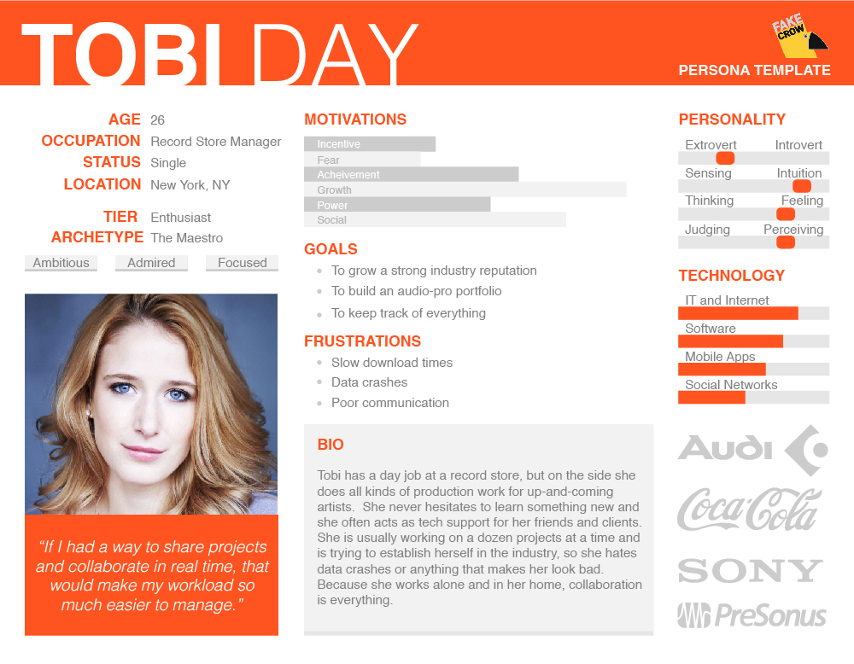
User Persona Example

Slide 22
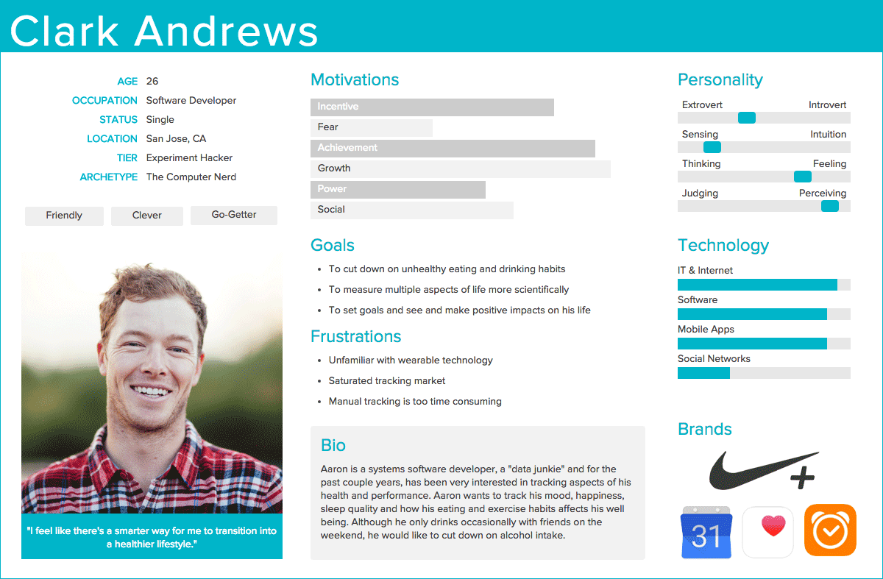
User Persona Example

Slide 23
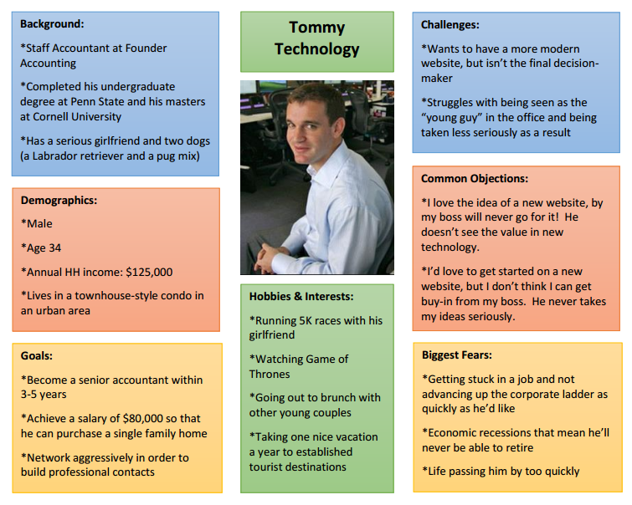
User Persona Example

Slide 24
Step 2 Understand Business Function
Tujuan :
Memahami pentingnya mengetahui fungsi bisnis berdasarkan Persona user sebagai acuan dalam merancang antarmuka perangkat lunak.
Mengerti dan menerapkan setiap tahapan dalam mengidentifikasi
alur kerja setiap task berdasarkan Persona User.

Slide 25
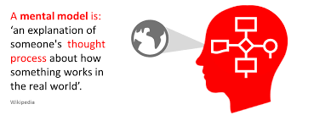
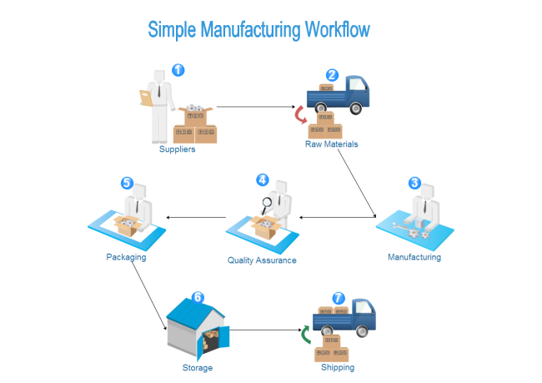
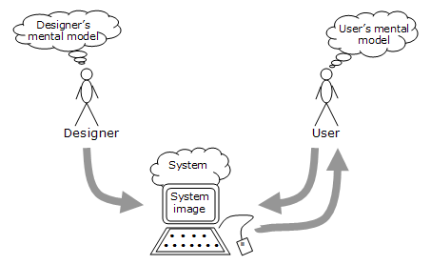
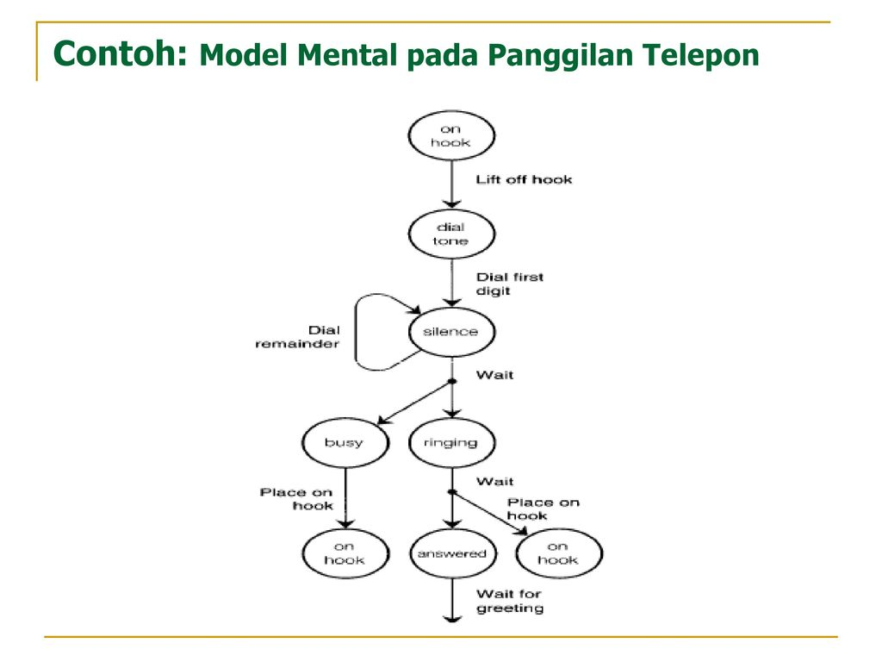
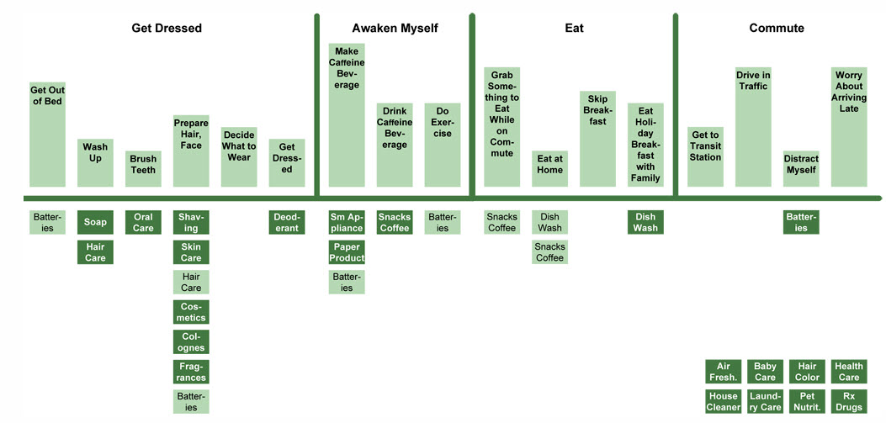
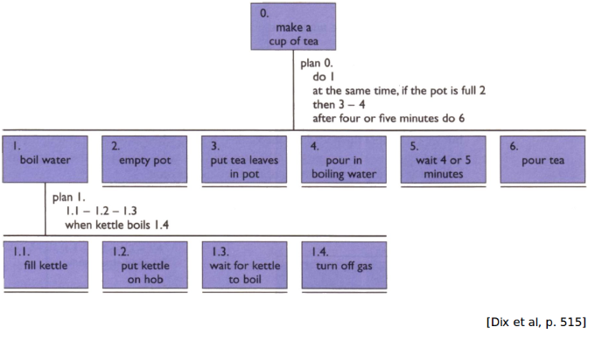

Slide 26
Step 3 Understand the Principles of Good Interface and Screen Design
Tujuan :
Menerapkan prinsip design interaksi dalam merancang antarmuka perangkat lunak untuk menghasilkan antarmuka perangkat lunak yang baik.
Basic Design Principles :
Consistency, Simplicity, Context

Slide 27
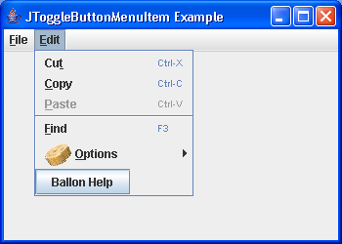
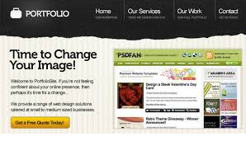
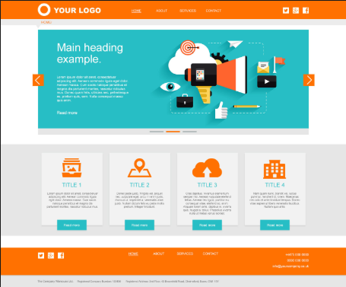
Step 4 Develop System Menu & Navigation
Tujuan :
Mahasiswa mampu merancang Struktur menu & navigasi yang sesuai dengan prinsip UI

Slide 28
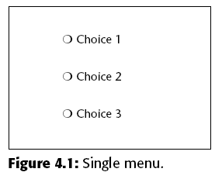
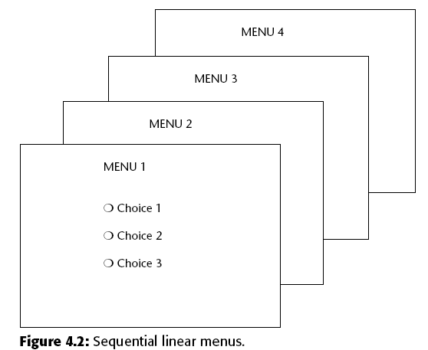
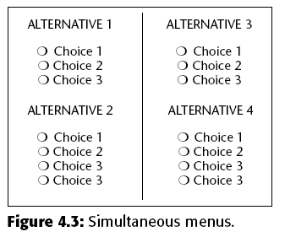
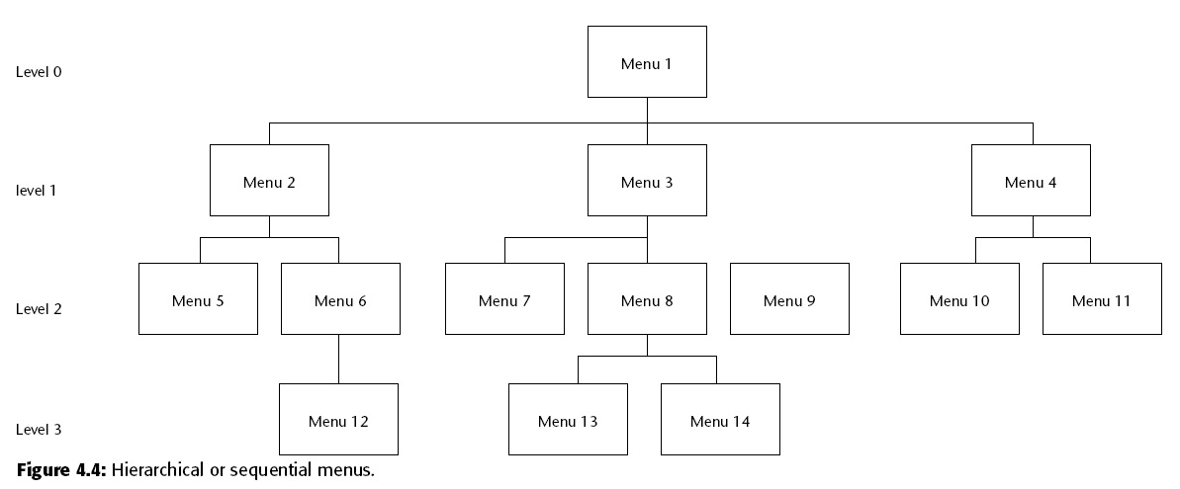
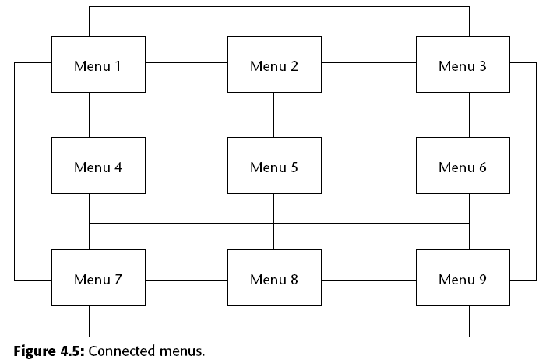
Struktur Menu
CSG2C3 - INTERAKSI MANUSIA DAN KOMPUTER

Slide 29
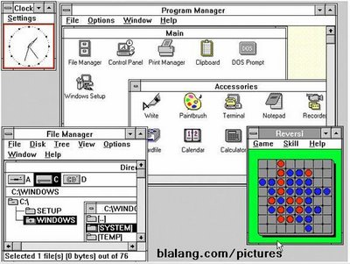
Step 5 Proper Windows
Tujuan :
Mahasiswa/i dapat mampu memilih dan merancang windows yang sesuai dengan kebutuhan.

Slide 30
Tipe-tipe Windows
Primary windows
Window utama yang muncul di layar saat sebuah aktivitas atau aksi dimulai
Disebut juga application window / main window / parent window
Merupakan titik utama aktivitas pengguna
Secondary windows
Windows tambahan yang dapat berupa independent maupun dependent window terhadap primary window-nya
Dapat berupa modal maupun modeless
Dialog box
Untuk memperluas dan melengkapi interaksi dengan aksi tertentu yang sangat terbatas
Untuk menampilkan pesan, aksi singkat, atau tombol command (OK, cancel, dll)

Slide 31
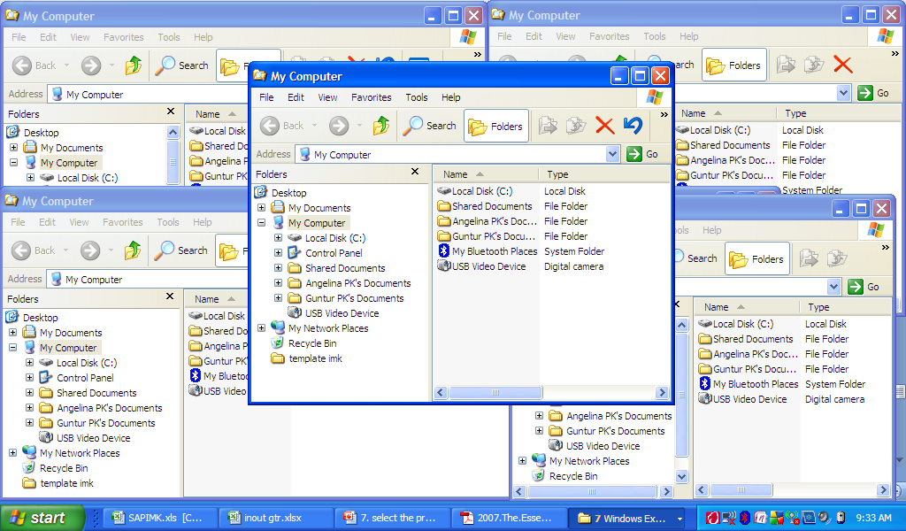
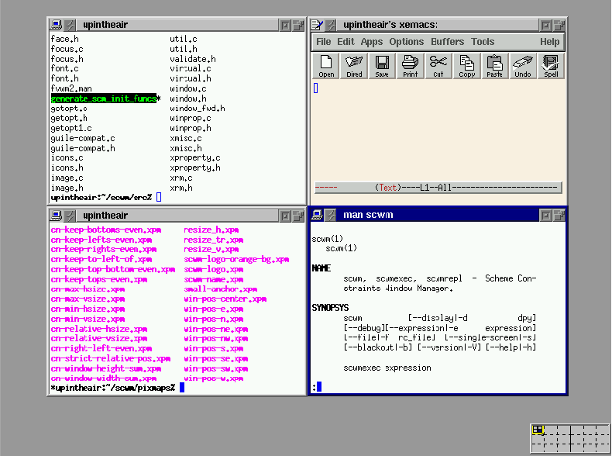
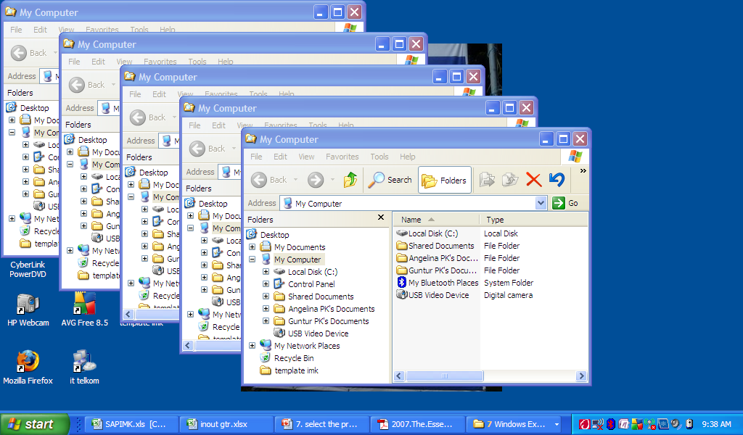
Gaya tampilan windows

Slide 32
Step 6 Proper Interaction Device
Tujuan :
Mahasiswa/i dapat mampu memahami karakteristik setiap perangkat interaksi sehingga dapat memilih perangkat interaksi yang tepat diterapkan dalam desain UI.

Slide 33
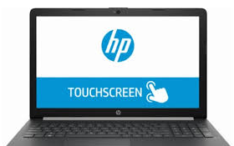
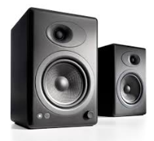
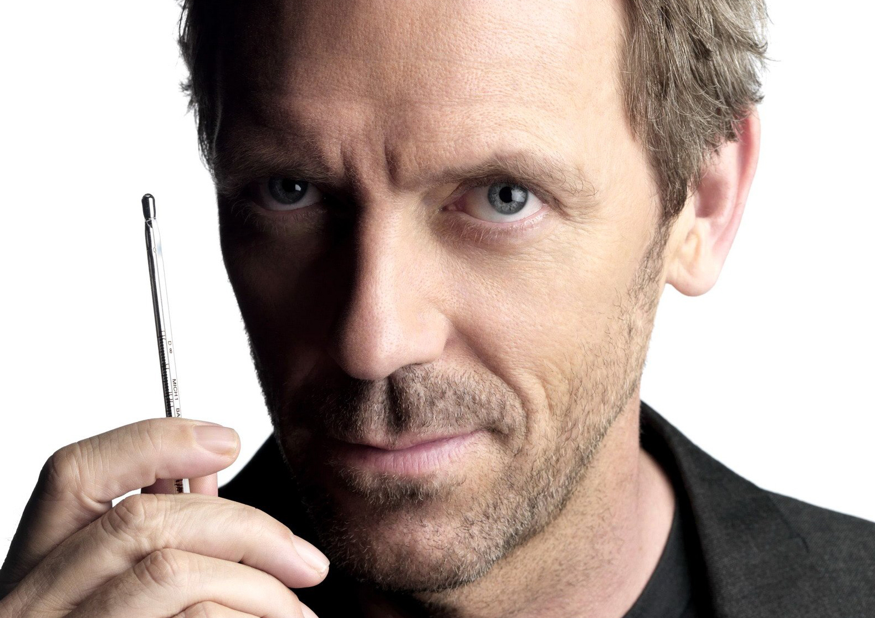
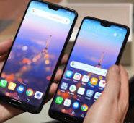
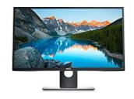
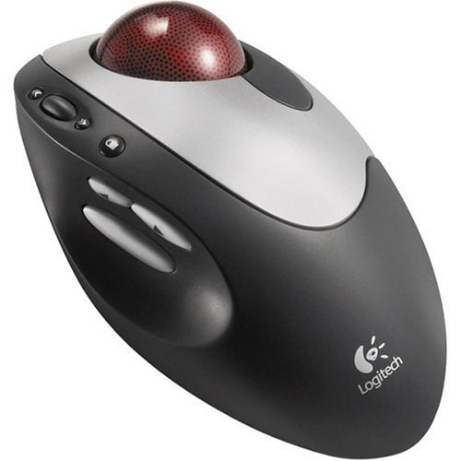
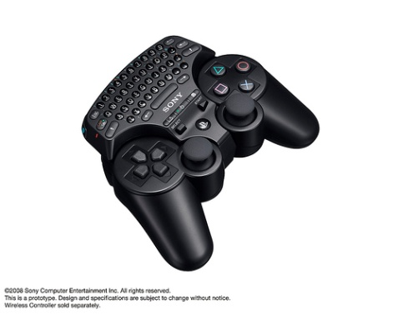
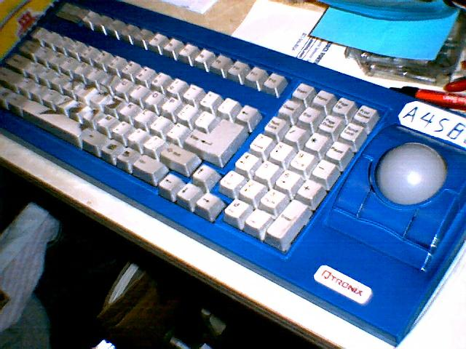
SELECTING THE PROPER INPUT DEVICE

Slide 34
Step 7 Screen Based Controls
Tujuan :
Mahasiswa/i mampu memilih dan menerapkan screen-based controls yang tepat dengan kebutuhan

Slide 35
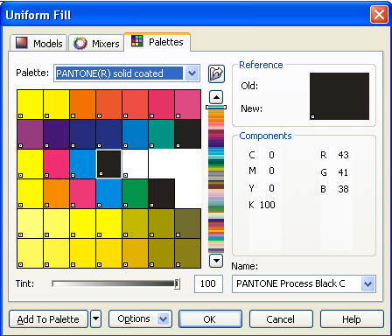
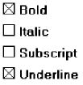

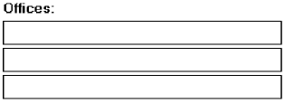

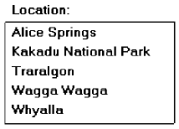

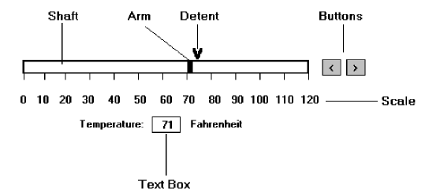
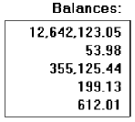

Controls examples
Single occurrence
Multiple occurrence
Or
Read-only / display
Segmentation
If alphanumeric then
left justify
If numeric then right
justify
Or

Slide 36
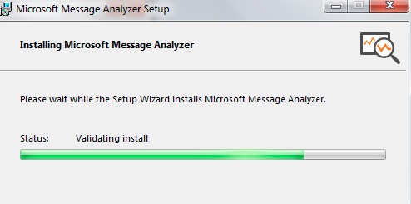
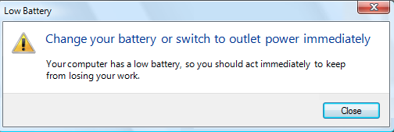
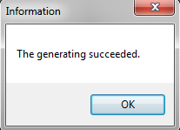
Step 8 Clear Text & Message
Tujuan :
Mahasiswa/i mampu merancang teks dan pesan yang tepat dan sesuai dengan prinsip UI

Slide 37
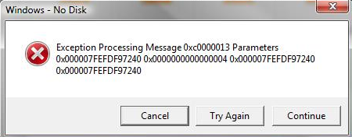
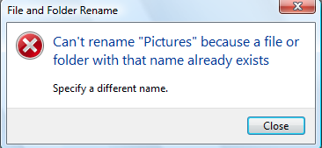
Which you prefer? Why?

Slide 38
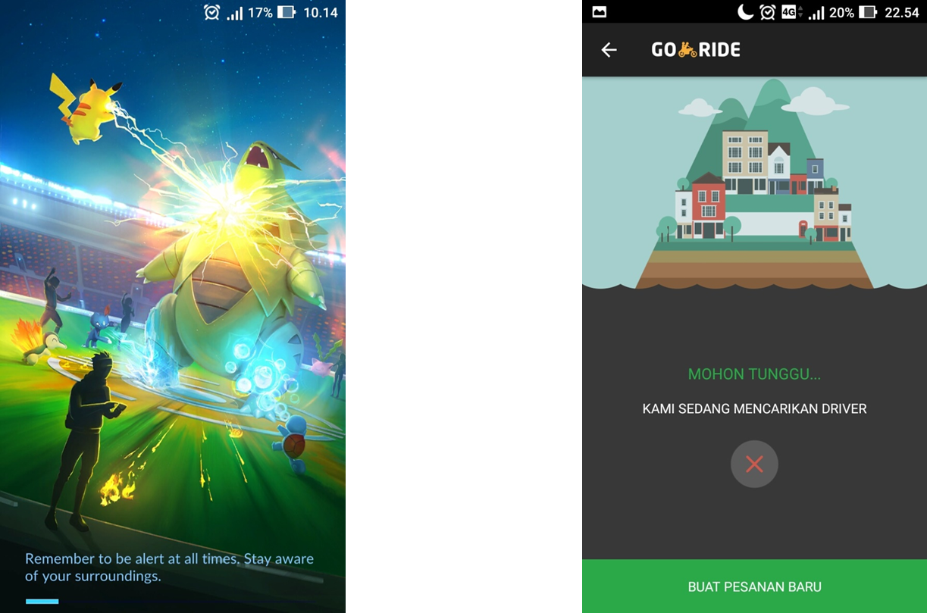
Step 9 : Provide Effective Feedback
Tujuan :
Mampu merancang feedback, guidance, dan assistance dengan efektif .

Slide 39
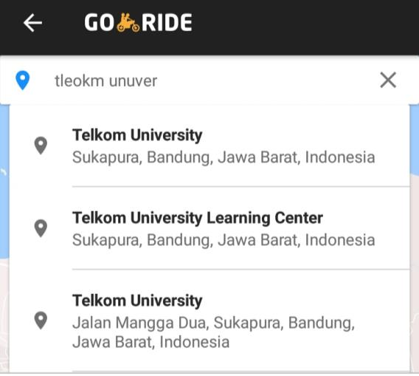
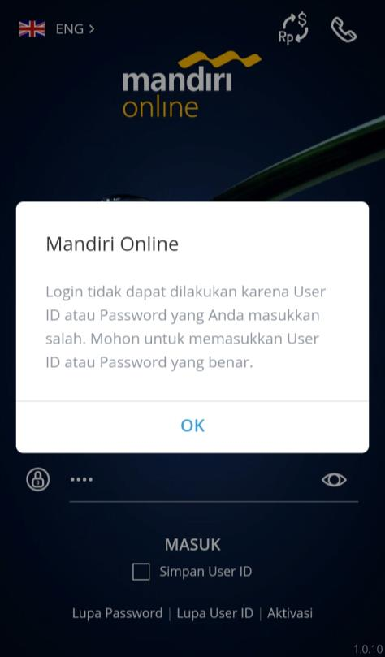
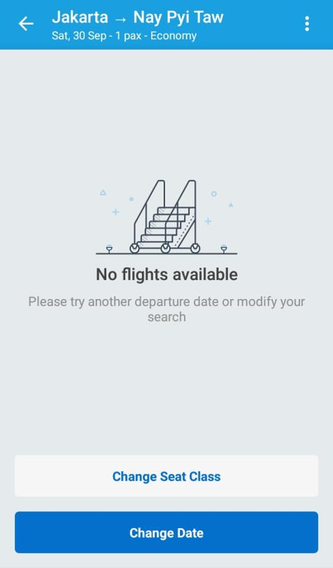

Slide 40
Step 10 Internasionalization & Accessibility
International considerations
Localization
Writing text
Accessibility considerations
Types of disabilities
Designing for accessibility
Cultural considerations
Using images and symbols

Slide 41
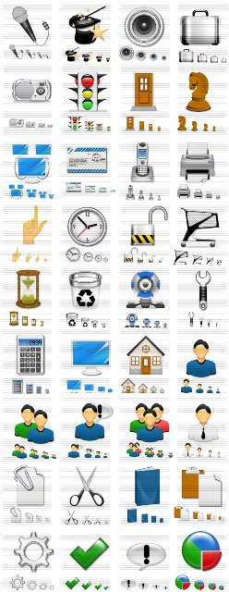
Step 11 Create Meaningful Graphics, Icons, and Images
Tujuan :
Mahasiswa/I mampu menerapkan Graphics, Icons, Images yang sesuai dengan kebutuhan
Icons are pictorial images most often used to represent objects and actions with which users can interact with or that they can manipulate.

Slide 42
Graphics
Images: should convey their intended messages
Image maps: to provide navigation links to other content
Photographs/ Pictures: used when every aspect of the image is relevant
Video: to show things moving/ changing over time
Diagrams: to show the structure/ relationship of objects
Drawings: when selected parts need to be emphasized/ represented
Animation: to explain ideas involving a change in time/ position
Audition: as a supplement to text and graphics

Slide 43
Learning Improvements for Various Media

Slide 44
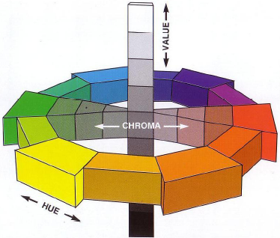
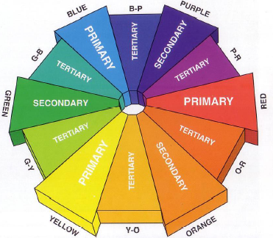
Step 12 Choose Proper Colors
Tujuan :
Mahasiswa/I mampu menerapkan warna yang sesuai dengan kebutuhan

Slide 45
Color
Color adds dimension, or realism, to screen usability.
Color draws attention because it attracts a person’s eye.
If used properly, it can emphasize the logical organization of information, facilitate the discrimination of screen components, accentuate differences among elements, and make displays more interesting and attractive.
If used improperly, color can be distracting and possibly visually fatiguing, impairing the system’s usability.

Slide 46
Step 13 Organize & Layout Windows & Page
Tujuan :
Mahasiswa/i dapat mampu menerapkan pengaturan dan tataletak Windows dan halaman web yang sesuai dan bermakna.
Mempercepat Pemahaman Informasi
Pengaturan/ Pengorganisasian Layout windows dan halaman web yang baik
Mempercepat Proses Eksekusi Task dan fungsi
Meningkatkan User Acceptance

Slide 47

Bagaimana menurut anda ketika tampilan awal photoshop adalah seperti ini??
Notes:
Too many, confusing
Smua fitur ditampilkan ➔ seharusnya yang ditampilkan adalah yang dibutuhkan saja
Letak fungsi tidak dikelompokkan sesuai domainnya….
Area kerja jadi terbatas….

Slide 48

Bagaimana menurut anda ketika tampilan awal photoshop adalah seperti ini?? BANDINGKAN!!

Slide 49




Step 14 Testing
Tujuan :
Mahasiswa/i dapat memahami konsep pengujian dalam desain UI dan cara mengukur UI

Slide 50
Bahan bacaan
Wilbert O. Galitz,2007,The Essential Guide to User Interface Design: An Introduction to GUI Design Principles and Techniques, Third Edition, Wiley Publishing, p.71-102 (dan untuk pertemuan minggu depan p.103-126)
https://uxmastery.com/what-does-a-user-centred-design-process-look-like/
http://knowledge.hubspot.com/contacts-user-guide/how-to-create-personas
http://www.smashingmagazine.com/2014/08/a-closer-look-at-personas-part-1/
http://webdesign.tutsplus.com/articles/defining-and-applying-personas-to-ux-design--webdesign-7561
http://www.storyboardthat.com/articles/software-development/using-personas-to-identify-your-target-customers

